Slide 1


AI and your Unpublished Writing: Risks of Using Large Language Models (LLMs)
September 10, 2025
Dr. Jodie Salter (she/her)
jsalter@uoguelph.ca
Writing Specialist
McLaughlin Library

Slide 2

PRESENTATION STRUCTURE
Risks
Mitigation Strategies
Guidance on Use

Slide 3
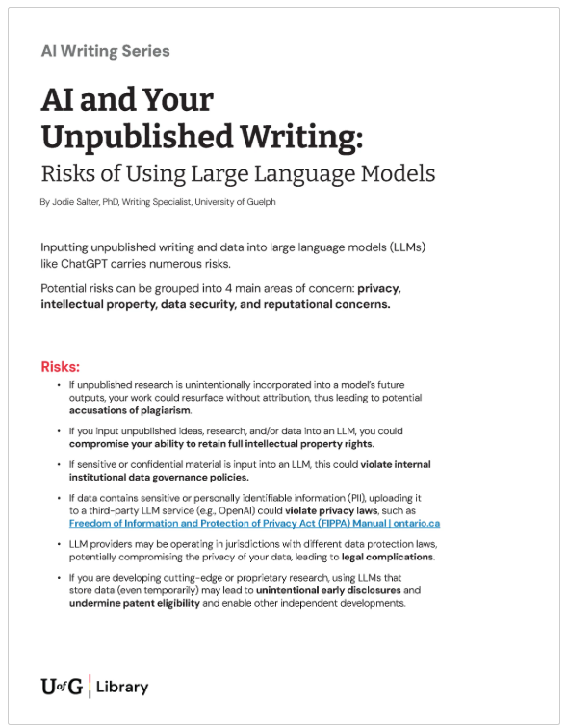
1-page handout on the
Library website
https://learningcommons.lib.uoguelph.ca

Slide 4
RISK Categories
Inputting unpublished writing and data into large language models (LLMs) like ChatGPT carries numerous risks in 4 areas of concern:
1
2
3
4
INTELLECTUAL PROPERTY
DATA SECURITY
PRIVACY
REPUTATION

Slide 5

RISK: Intellectual Property
If you input unpublished ideas, research, writing, and/or data into an LLM, you could compromise your ability to retain full intellectual property rights.
You risk losing the option of publishing your work in a journal or as part of your thesis.
Be aware of all the risks before using any LLM.

Slide 6

RISK: Intellectual Property
If unpublished research or writing is (un)intentionally incorporated into a model's training and future outputs, your work could resurface without attribution, thus leading to potential accusations of plagiarism.
If you are developing cutting-edge or proprietary research, using LLMs that store data (even temporarily) may lead to unintentional early disclosures, which could undermine patent eligibility and/or enable other independent developments.

Slide 7

RISK: Privacy
If sensitive or confidential material is input into an LLM, this sharing could violate internal institutional data governance policies.
If data contains sensitive or personally identifiable information (PII), this sharing could violate privacy laws, such as Freedom of Information and Protection of Privacy Act (FIPPA) Manual | ontario.ca

Slide 8

RISK: Data Security
LLM providers may be operating in jurisdictions (countries) with different data protection laws, potentially compromising the privacy of your data, leading to legal complications.

Slide 9

All of these actions hold reputational risk for you, the University of Guelph, and your research partners.

Slide 10
Mitigation Strategies
Before using any generative AI tool to support your research and writing, educate yourself about ...
1
2
3
4
TERMS OF USE & PRIVACY
APPROVALS
& DISCLOSURES
DATA
MANAGEMENT
STORAGE & TRAINING

Slide 11

TERMS of USE and PRIVACY
Read the AI provider’s “Terms of Use and Privacy Policy” to understand how input data is used and who owns the generated data.
Questions can be directed to
U of G Information Security Team at infosec@uoguelph.ca
CCS at ithelp@uoguelph.ca

Slide 12

APPROVALS
To use AI tools for any part of your research or writing process, you must comply with specified terms and conditions for approved use from
thesis and lab supervisors
research partners
data owners
project sponsors
peer-review journals
granting agencies (e.g., SSHRC, NSERC, CIHR)

Slide 13

DISCLOSURES
Researchers need to disclose any use of AI when applying for research grants from the Tri-Council (SSHRC, NSERC, CIHR):
"Applicants must state if and how generative AI has been used in the development of their application and are required to follow specific instructions, which will be provided for each funding opportunity as they become available."
Guidance on the use of Artificial Intelligence in the development and review of research grant proposals (This policy came into effect in November 2024.)

Slide 14

DATA MANAGEMENT POLICIES
Know the university’s organizational research data management and AI-use policies, and follow them:
Research Data Classification
Data Storage Guidelines
Acceptable Use Policy (AUP)
Safeguarding Research | Office of Research
Information Security Guidelines for the Use of Generative Artificial Intelligence

Slide 15

STORAGE & TRAINING
Know which providers store and use data for training,
and do NOT use them for your own unpublished writing and data!

Slide 16
Comparison Table: AI Providers, Training, and Data Storage
Provider | Uses Inputs to Train | Can Opt Out | Fully Private Option | Data Storage
ChatGPT - Free | Yes ❌ | ✅ Yes – in Settings > Data Controls | No ❌ | Yes ❌
Copilot - Free | Yes ❌ | No ❌ | No ❌ | Yes ❌
Anthropic (Claude) - Free/Pro/Max *system change on Aug 28, 2025 | Yes ❌ | No ❌ | No ❌ | Yes ❌
ChatGPT - Plus/Pro ($$) | Yes ❌ | ✅ Yes | No, but does offer temporary incognito mode | ✅ Yes, but - data may be retained for 30 days, while Enterprise/Team plans offer zero data retention options.
Microsoft 365 CoPilot (U of G licensed version) | ✅ No | ✅ n/a | ✅ n/a | ✅ Yes - caches data briefly during a session, but does not permanently store prompts, files, or responses.

Slide 17
MICROSOFT 365 COPILOT CHAT – U of G licensed version
All U of G students, staff, faculty and IT admins have access to Microsoft Copilot Chat through their Microsoft 365 A5 subscription. This AI-driven assistant facilitates real-time communication, answers queries, and aids in task completion.
“While public tools may have access to larger training datasets, the advantages of using a private generative AI tool include more control over the data and output, higher security and privacy, and lower ethical and legal risks.” (U of G Information Security Guidelines)
Microsoft 365 Copilot Chat offers enterprise data protection (EDP).
View details on Copilot Chat privacy and protections.
U of G users can find more information on CCS Microsoft Copilot Sharepoint site.

Slide 18


When you plan to use AI providers and tools to support your research and writing...

Slide 19
Guidance to follow when using LLMs
Do not input your qualitative (or quantitative) data into an LLM unless you have all applicable approvals.
Obtain consent from data subjects if you plan to use an AI tool to collect, process, or disclose personal data.
Inform data subjects of the purpose, scope, potential risks, and provide an option to opt out.
Excerpt: U of G Information Security Guidelines for the Use of Generative Artificial Intelligence

Slide 20
Guidance to follow when using LLMs
Extra care should be exercised whenever sharing information in an AI tool.
Remove any personally identifiable information (PII) and sensitive data before inputting into any LLMs.
Internal (S2), Confidential (S3) and Restricted (S4) University data should never be entered into a public AI tool (e.g., ChatGPT) or used in a generative AI prompt.
Excerpt: U of G Information Security Guidelines for the Use of Generative Artificial Intelligence

Slide 21
Guidance to follow when using LLMs
Use AI-generated content carefully and appropriately.
Ensure system outputs are not identical or substantially similar to copyright protected material.
Remove problematic material to minimize the risk of intellectual property infringement.
Excerpt: U of G Information Security Guidelines for the Use of Generative Artificial Intelligence

Slide 22
Guidance to follow when using LLMs
Give proper attribution where appropriate.
Indicate explicitly and clearly that generative AI was used to develop content.
If AI-use permitted, properly cite AI-generated work.
Excerpt: U of G Information Security Guidelines for the Use of Generative Artificial Intelligence

Slide 23

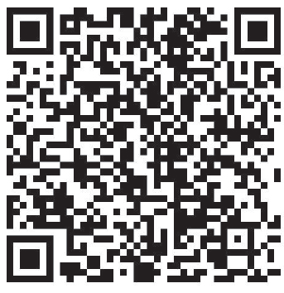

QUESTIONS?
Dr. Jodie Salter
jsalter@uoguelph.ca
UG Information Security Team
infosec@uoguelph.ca
Book an Appointment

Slide 24

Creative Commons License

